Slide 1
Overview of Python Packages for Data Analysis
Yuan Long

Slide 3
Mathematics
NumPy – Powerful computational framework.
pandas – Data structures and data analysis.
matplotlib – Plotting and visualization tools.
Machine Learning
Scikit learn – Machine Learning toolkit.

Slide 4
Text Mining
Scikit learn – Machine Learning toolkit.
NLTK – Working with human language data.
Image processing
Scikit image – Image processing toolkit.

Slide 6
Performing Fundamental Scientific Computing Using NumPy
The NumPy library provides the means for performing n-dimensional array manipulation, which is critical for data science work.
Celsius to Fahrenheit
values = [23.1, 45.8, 94.4, 44.2]
import numpy as np
np_array = np.array(values) print(np_array * 9 / 5 + 32)
for v in values:
print(v * 9 / 5 + 32)

Slide 7
Performing Data Analysis Using Pandas
The Pandas library provides support for data structures and data analysis tools. The library is optimized to perform data science tasks especially fast and efficiently.
df = pd.read_csv(’test.csv’)
type(df)

Slide 8
Implementing Machine Learning Using Scikit-Learn
The Scikit-learn library is one of a number of Scikit libraries that build on the capabilities provided by NumPy and SciPy to allow Python developers to perform domain-specific tasks. It provides access to the following sorts of functionality:
Classification
Regression
Clustering
Dimensionality reduction
Model selection
Preprocessing

Slide 9
Plotting the Data Using Matplotlib
The matplotlib library provides you with a MATLAB-like interface for creating data presentations of the analysis you perform.
The library is currently limited to 2D output, but it still provides you with the means to express graphically the data patterns you see in the data you analyze.
Notes:
Without this library, you couldn't create output that people outside the data science community could easily understand.

Slide 10
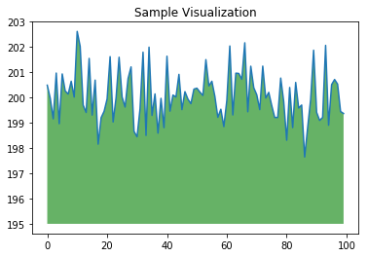
import numpy as np
from matplotlib import pyplot as plt
ys = 200 + np.random.randn(100)
x = [x for x in range(len(ys))]
plt.plot(x, ys, '-')
plt.fill_between(x, ys, 195, where=(ys > 195), facecolor='g', alpha=0.6)
plt.title("Sample Visualization")
plt.show()

